Slide 1



T&O Innovation
May 2018

Slide 2
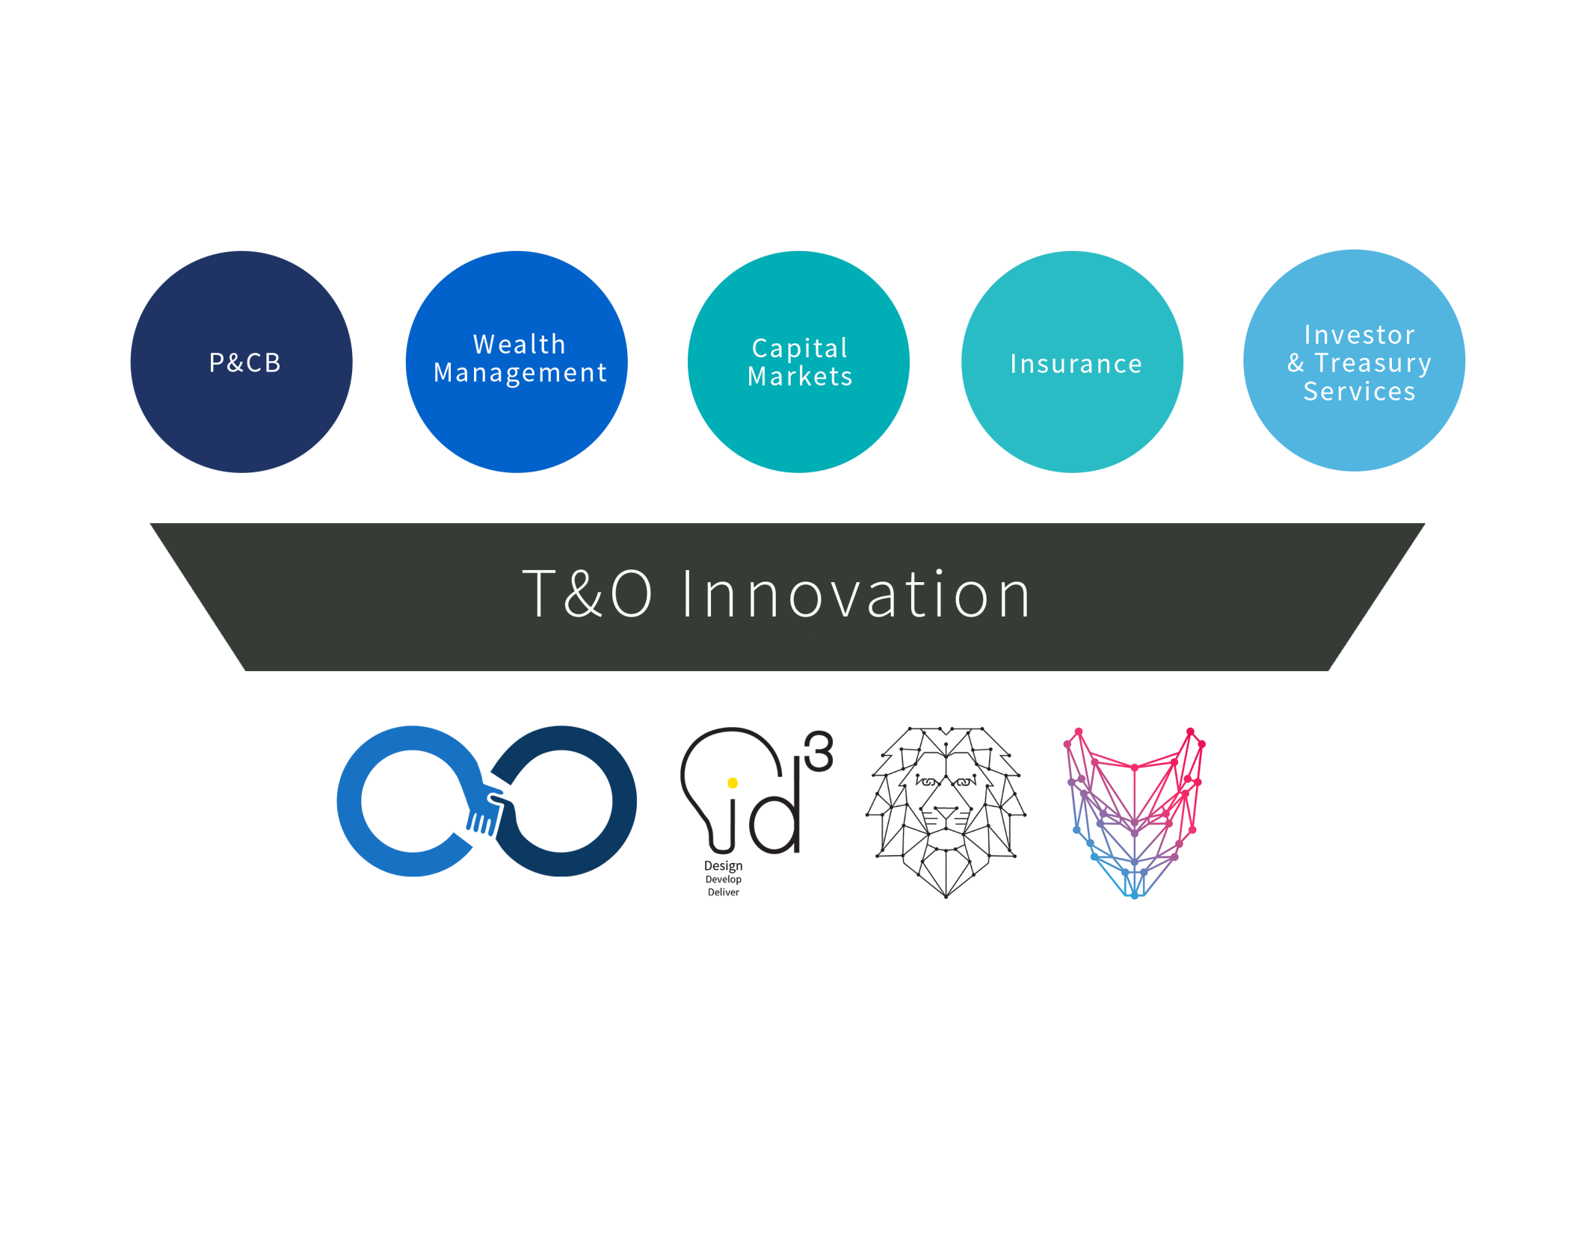






Notes:
So why is Innovation important for RBC? We support all of RBC’s business lines in integrating innovative technology to leap ahead of the competition.
A recent Thomson Reuters survey found that 68% of wealth managers say learning about and keeping up with new technology is the top challenge they face and 69% are concerned about staying relevant to a younger generation of investors.
T&O Innovation is constantly working on multiple projects in partnership with lines of business across the bank.

Slide 3






2018 Strategic Priorities
To be a hub within RBC that partners, experiments, builds and delivers next-generation technology solutions across the enterprise and lines of business
Build and leverage academic partnerships to support research and to recruit best-in-class talent
Deliver the best of the digital ecosystem to RBC business lines to capitalize on new technologies
Explore and test Next-Gen Tech and new business models to identify future opportunities and disruptive technologies
Notes:
So, who are we? T&O Innovation is a hub within RBC that partners, experiments, builds and delivers next-generation technology solutions across the enterprise and lines of business.
Our goals are to:
Partner with enterprise teams to experiment with and deliver new technologies that will transform the bank,
Build strategic partnerships and sponsorships within the startup and fintech ecosystem and with academic institutions,
Lead bank-wide adoption of next-gen technologies, and
Collaborate across RBC and support the alignment of innovation strategies across the bank and lines of business.

Slide 4
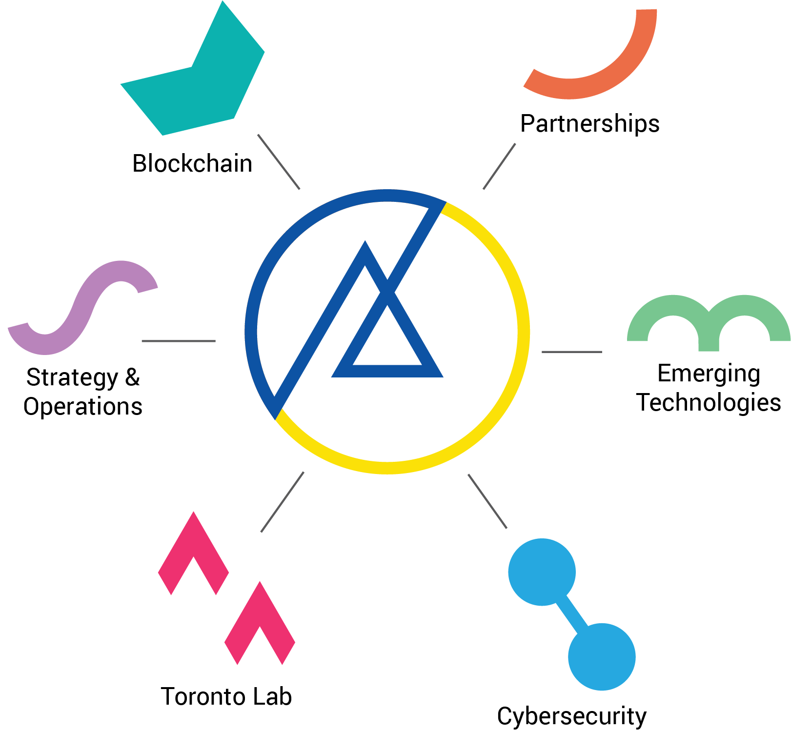
T&O Innovation Team
Notes:
Our team is composed of four pillars:
Our Blockchain CoE is researching and developing potential use cases for the technology as well as consulting across the lines of business.
Our iD3 team is designing and testing the latest technologies to deliver the best of the digital ecosystem to RBC’s lines of business and customers.
Our partnerships team keeps RBC tied into the FinTech ecosystem so we can source the most promising startups and technologies for new RBC products and services.
Our cybersecurity team works with groundbreaking academics to create the most future-proof security solutions for protecting RBC’s assets.

Slide 5










Innovation 3.0
Alex Peh
VP, Innovation T&O
Silu Modi
Director, Partnership
Kaushik Venkatadri
Senior Director, Blockchain
Syd Millett
Senior Director, ID3 Lab
Kory Fong
Head, Cyber Security
Lara Kulach
Director, Strategy & Ops
Notes:
Leadership

Slide 6



INNOVATION PARTNERSHIPS
Notes:
Led by Silu Modi (add leadership?)

Slide 7
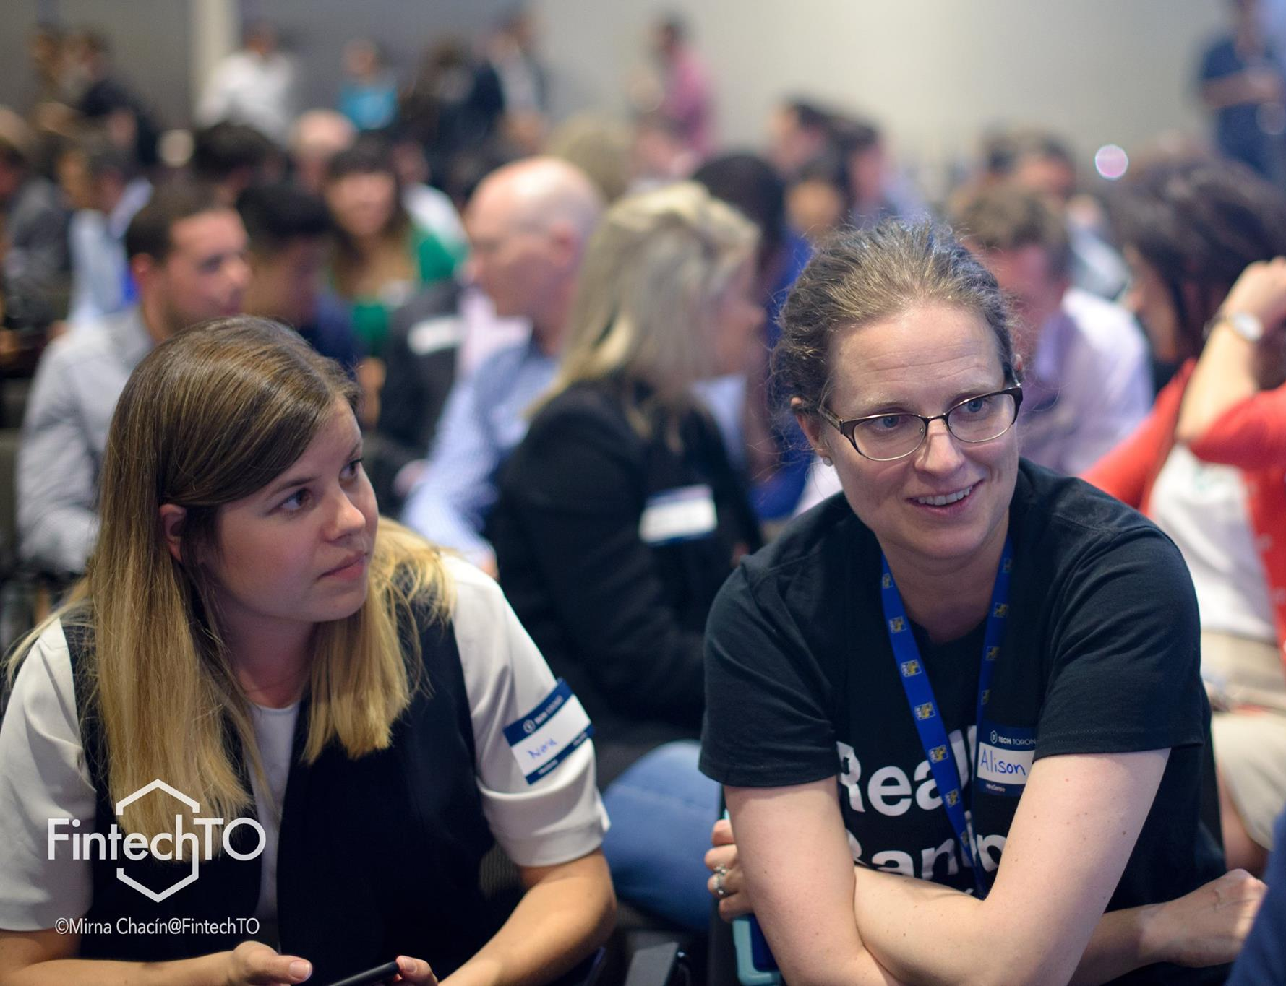
Who are we?
We are the eyes and ears of RBC in the Fintech and startup ecosystem. We identify the most promising technologies and find a place for them within the bank.
Notes:
We build relationships with key players in the tech ecosystems including incubators, accelerators, and universities; we house the Startup CoE, where we connect LoBs and high-potential startups; and we share knowledge within RBC to lead the adoption of innovation and new technology.
We are the eyes and ears of RBC in the Fintech and startup ecosystem. We identify the most promising technologies and find a place for them within the bank.

Slide 8



OUR MANDATE
We match high-potential startups with business needs
We build deep connections with the fintech and startup ecosystem
We connect T&O Innovation back to the rest of RBC

Slide 9

TORONTO LAB
DESIGN. DEVELOP. DELIVER.
Notes:
Led by Syd Millett

Slide 10
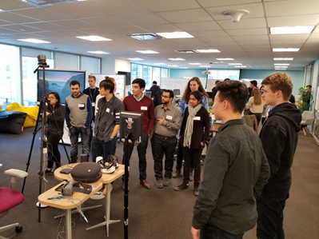
Who are we?
We partner with high-potential technology companies and internal teams to design, develop, and deliver proof-of-concepts for RBC.
Notes:
ID³ Lab:
Our Mandate
Leverage new technologies to transform the bank from within.
Partner with teams across the Enterprise to take new ideas end-to-end, from early strategy to solution design and development all the way through to delivery
Focus on building reusable technology
Share experience and knowledge across the bank

Slide 11



OUR MANDATE
Develop innovative products in partnership with internal teams
Design technologies to transform the bank from within
Deliver reusable technology
Notes:
What we do:
Leverage new technologies to transform the bank from within.
Partner with teams across the Enterprise to take new ideas end-to-end, from early strategy to solution design and development all the way through to delivery
Focus on building reusable technology
Share experience and knowledge across the bank

Slide 12


2018 Priorities
Promote the RBC Innovation Brand externally through conferences, panels and the tech community
Mature capability in developing production grade applications & solutions
Execute OC-sponsored pilots and prototypes prioritized using the Innovation Scorecard process
Drive awareness of iD³ projects and initiatives; use transparency to promote reuse of technology

Slide 13


BLOCKCHAIN
Notes:
Led by Kaushik Venkatadri

Slide 14
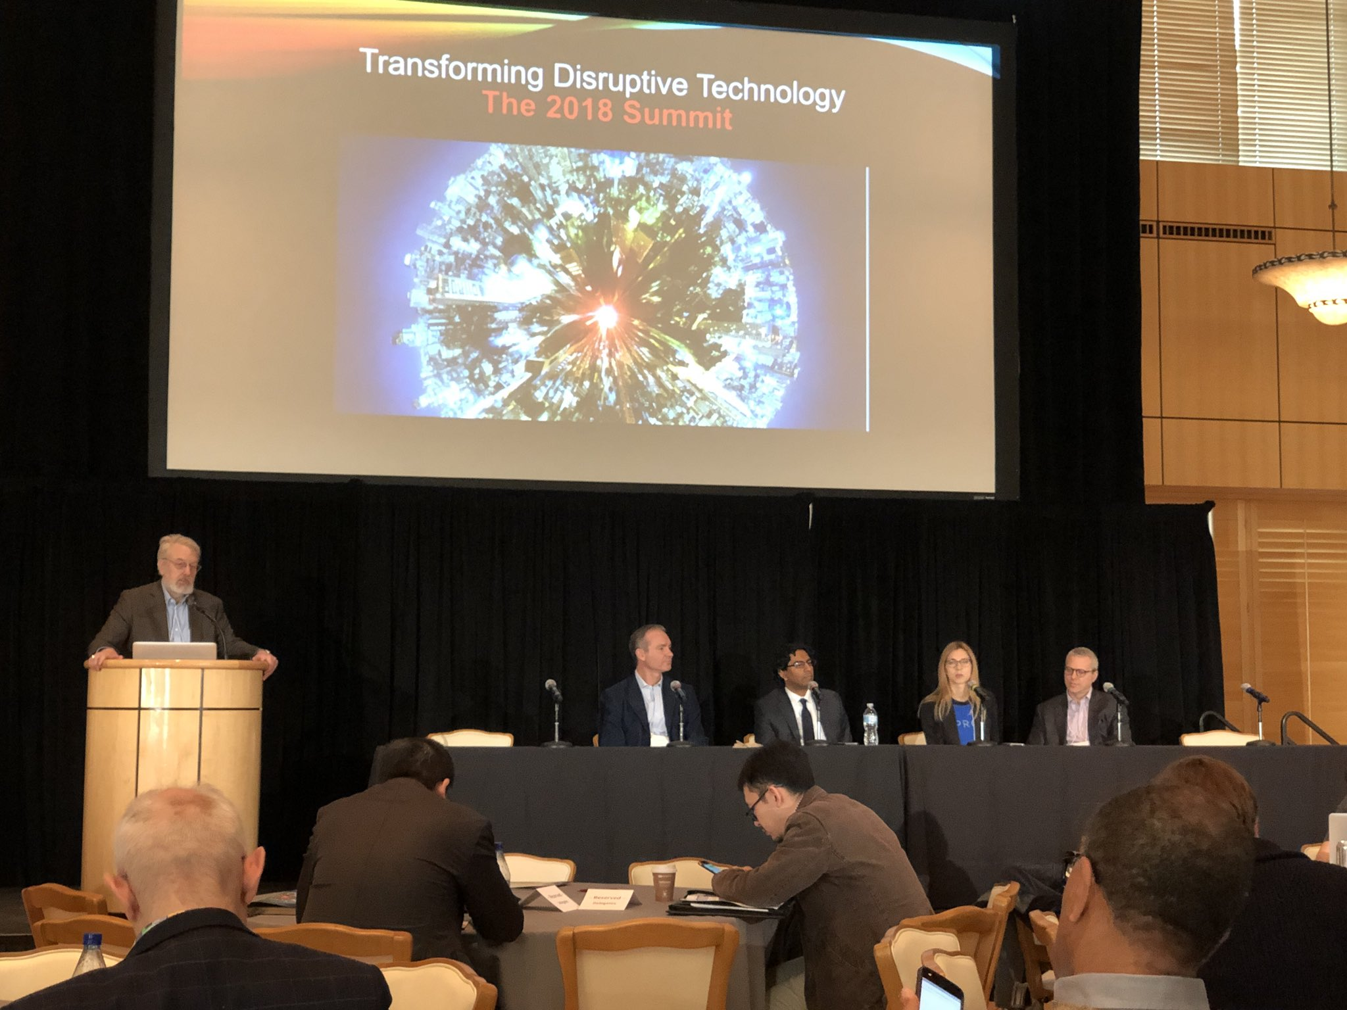
Who are we?
We research, identify and develop use cases for blockchain technology to reinforce RBC’s position as a leader in digital transformation.

Slide 15


OUR MANDATE
Explore use cases for blockchain technology in the finance industry
Build RBC expertise through training and community building
Develop blockchain source code for real-world use

Slide 16
2018 Priorities
Continue to provide technology support for initiatives and projects being executed outside the CoE
Continue to maintain a view of blockchain activity across all of RBC
Incubate our second RBC Blockchain network, leveraging vendors, consortia and open source to move RBC closer to building a complex system of record
Develop an RBC wide blockchain community that practitioners across the bank can share and collaborate

Slide 17


CYBERSECURITY
Notes:
Led by Kory Fong

Slide 18
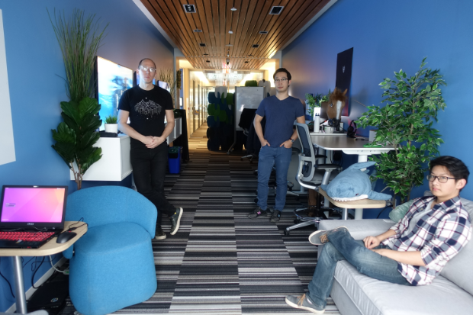
Who are we?
Our mission is to advance cybersecurity research through in-house expertise and partnerships with top-tier academic institutions

Slide 19
OUR MANDATE
Partner with leading academics and emerging tech companies
Develop security solutions for tomorrow’s threats
Research and produce original IP that can be published or patented

Slide 20
2018 Priorities
Launch an RBC cybersecurity lab on campus at the University of Waterloo
Build out a Post-Quantum roadmap for RBC
Drive industry leading research through collaboration projects with U of W, U of T, IQC and startup partners
Launch an RBC lab on site at Cyberspark in Israel

Slide 21
T&O Innovation
May 2018

Slide 22
Notes:
So why is Innovation important for RBC? We support all of RBC’s business lines in integrating innovative technology to leap ahead of the competition.
A recent Thomson Reuters survey found that 68% of wealth managers say learning about and keeping up with new technology is the top challenge they face and 69% are concerned about staying relevant to a younger generation of investors.
T&O Innovation is constantly working on multiple projects in partnership with lines of business across the bank.

Slide 23
2018 Strategic Priorities
To be a hub within RBC that partners, experiments, builds and delivers next-generation technology solutions across the enterprise and lines of business
Build and leverage academic partnerships to support research and to recruit best-in-class talent
Deliver the best of the digital ecosystem to RBC business lines to capitalize on new technologies
Explore and test Next-Gen Tech and new business models to identify future opportunities and disruptive technologies
Notes:
So, who are we? T&O Innovation is a hub within RBC that partners, experiments, builds and delivers next-generation technology solutions across the enterprise and lines of business.
Our goals are to:
Partner with enterprise teams to experiment with and deliver new technologies that will transform the bank,
Build strategic partnerships and sponsorships within the startup and fintech ecosystem and with academic institutions,
Lead bank-wide adoption of next-gen technologies, and
Collaborate across RBC and support the alignment of innovation strategies across the bank and lines of business.

Slide 24
T&O Innovation Team
Notes:
Our team is composed of four pillars:
Our Blockchain CoE is researching and developing potential use cases for the technology as well as consulting across the lines of business.
Our iD3 team is designing and testing the latest technologies to deliver the best of the digital ecosystem to RBC’s lines of business and customers.
Our partnerships team keeps RBC tied into the FinTech ecosystem so we can source the most promising startups and technologies for new RBC products and services.
Our cybersecurity team works with groundbreaking academics to create the most future-proof security solutions for protecting RBC’s assets.

Slide 25
Innovation 3.0
Alex Peh
VP, Innovation T&O
Silu Modi
Director, Partnership
Kaushik Venkatadri
Senior Director, Blockchain
Syd Millett
Senior Director, ID3 Lab
Kory Fong
Head, Cyber Security
Lara Kulach
Director, Strategy & Ops
Notes:
Leadership

Slide 26
INNOVATION PARTNERSHIPS
Notes:
Led by Silu Modi (add leadership?)

Slide 27
Who are we?
We are the eyes and ears of RBC in the Fintech and startup ecosystem. We identify the most promising technologies and find a place for them within the bank.
Notes:
We build relationships with key players in the tech ecosystems including incubators, accelerators, and universities; we house the Startup CoE, where we connect LoBs and high-potential startups; and we share knowledge within RBC to lead the adoption of innovation and new technology.
We are the eyes and ears of RBC in the Fintech and startup ecosystem. We identify the most promising technologies and find a place for them within the bank.

Slide 28
OUR MANDATE
We match high-potential startups with business needs
We build deep connections with the fintech and startup ecosystem
We connect T&O Innovation back to the rest of RBC

Slide 29
TORONTO LAB
DESIGN. DEVELOP. DELIVER.
Notes:
Led by Syd Millett

Slide 30
Who are we?
We partner with high-potential technology companies and internal teams to design, develop, and deliver proof-of-concepts for RBC.
Notes:
ID³ Lab:
Our Mandate
Leverage new technologies to transform the bank from within.
Partner with teams across the Enterprise to take new ideas end-to-end, from early strategy to solution design and development all the way through to delivery
Focus on building reusable technology
Share experience and knowledge across the bank

Slide 31
OUR MANDATE
Develop innovative products in partnership with internal teams
Design technologies to transform the bank from within
Deliver reusable technology
Notes:
What we do:
Leverage new technologies to transform the bank from within.
Partner with teams across the Enterprise to take new ideas end-to-end, from early strategy to solution design and development all the way through to delivery
Focus on building reusable technology
Share experience and knowledge across the bank

Slide 32
2018 Priorities
Promote the RBC Innovation Brand externally through conferences, panels and the tech community
Mature capability in developing production grade applications & solutions
Execute OC-sponsored pilots and prototypes prioritized using the Innovation Scorecard process
Drive awareness of iD³ projects and initiatives; use transparency to promote reuse of technology

Slide 33
BLOCKCHAIN
Notes:
Led by Kaushik Venkatadri

Slide 34
Who are we?
We research, identify and develop use cases for blockchain technology to reinforce RBC’s position as a leader in digital transformation.

Slide 35
OUR MANDATE
Explore use cases for blockchain technology in the finance industry
Build RBC expertise through training and community building
Develop blockchain source code for real-world use

Slide 36
2018 Priorities
Continue to provide technology support for initiatives and projects being executed outside the CoE
Continue to maintain a view of blockchain activity across all of RBC
Incubate our second RBC Blockchain network, leveraging vendors, consortia and open source to move RBC closer to building a complex system of record
Develop an RBC wide blockchain community that practitioners across the bank can share and collaborate

Slide 37
CYBERSECURITY
Notes:
Led by Kory Fong

Slide 38
Who are we?
Our mission is to advance cybersecurity research through in-house expertise and partnerships with top-tier academic institutions

Slide 39
OUR MANDATE
Partner with leading academics and emerging tech companies
Develop security solutions for tomorrow’s threats
Research and produce original IP that can be published or patented

Slide 40
2018 Priorities
Launch an RBC cybersecurity lab on campus at the University of Waterloo
Build out a Post-Quantum roadmap for RBC
Drive industry leading research through collaboration projects with U of W, U of T, IQC and startup partners
Launch an RBC lab on site at Cyberspark in Israel

